Slide 1
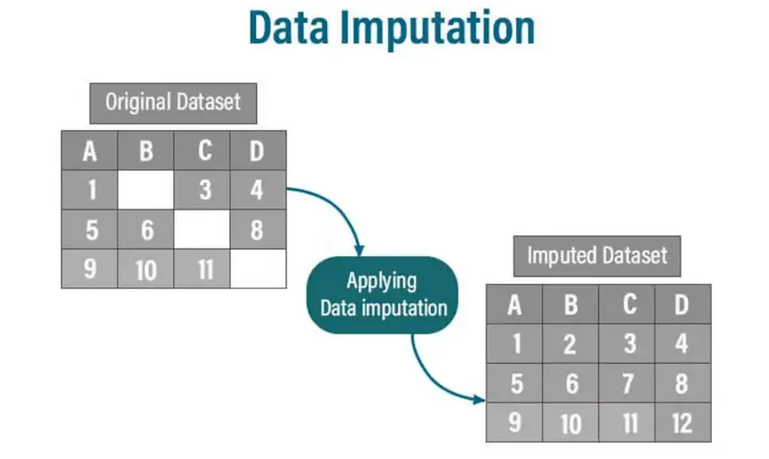
Handling the Void (Imputation Strategy)
The Problem: Real-world data is rarely complete. Deleting every row with a missing value can destroy 50% of your dataset.
The Solution: Scientific Imputation.
Mean: Best for normally distributed data.
Median: Best for skewed data (like salaries) as it ignores outliers.
Mode: The "Most Frequent" choice for categorical data (like City names).

Slide 2
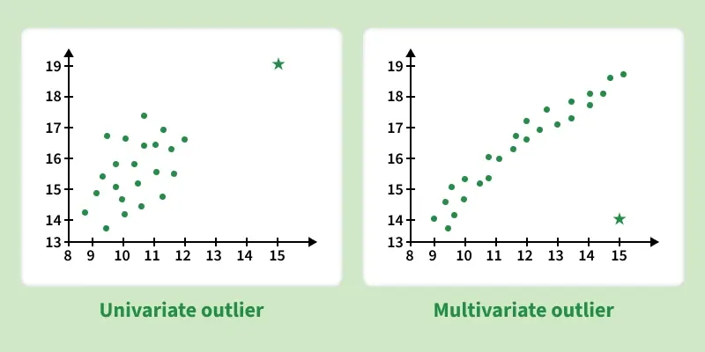
Outlier Engineering (Finding the "Impossible")
What are Outliers?: Data points that don't fit the pattern (e.g., an "Age" of 250 or a "Price" of -10).
Detection Methods:
Z-Score: Measures how many standard deviations a point is from the mean.
IQR (Interquartile Range): The middle 50% of the data. Anything significantly outside the "whiskers" of a boxplot is flagged.
Outcome: We don't always delete outliers; sometimes we "clip" them to a maximum logical value.

Slide 3
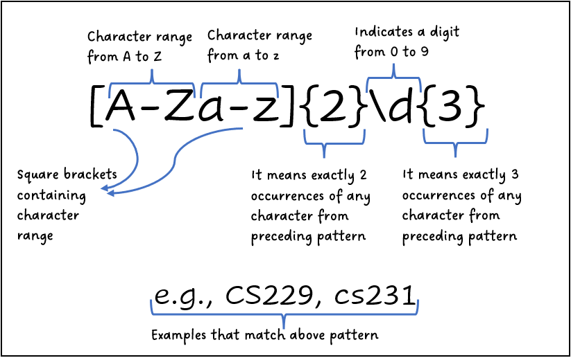
String Cleaning (The Power of Regex)
Messy Text: Computers see "Peshawar", "peshawar", and "Peshawar " as three different cities.
String Methods: Using .str.strip() and .str.lower() to unify text.
Regular Expressions (Regex): Powerful pattern-matching logic to extract phone numbers from text or fix email typos automatically.

Slide 4
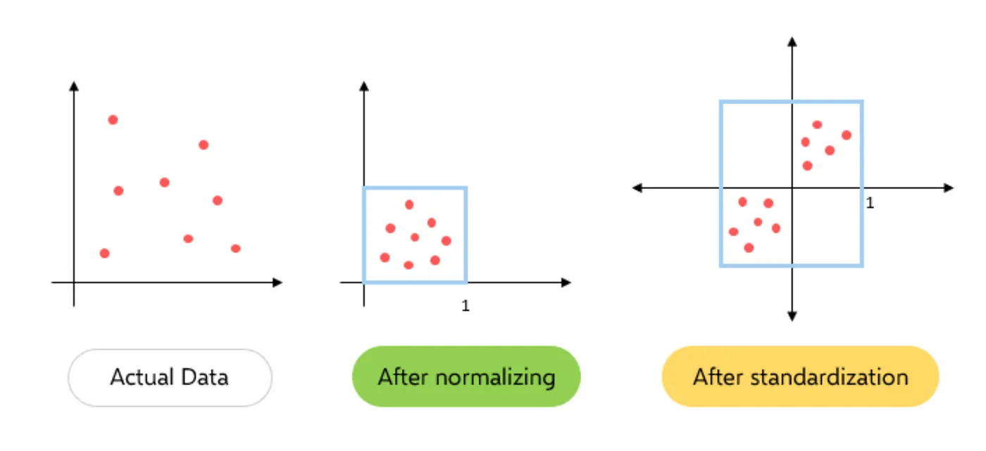
Standardization & Scaling
The Magnitude Problem: A computer thinks a "Salary" of 100,000 is "more important" than an "Age" of 30 just because the number is bigger.
Standardization: Centering data around 0 with a standard deviation of 1.
Normalization: Squishing all values between 0 and 1.
Goal: Ensuring the model treats all "features" (columns) with equal mathematical respect.

